Slide 1
Customizing Master Pages
modifying OOTB master pages
Notes:
This lecture begins by reviewing the ASP.NET syntax required to work with master pages and by examining the full list of the 34 placeholders controls defined in the standard master pages such as v4.master. There will be a walkthrough of the standard master page named v4.master from top to bottom in which you will learn about the built-in SharePoint controls that are used to link to CSS files and JavaScript files and to provide essential aspects of the SharePoint user interface such as the three common navigation controls. The lecture concludes with a demonstration of how to reconfigure the master page for a Team Site and to customize this master page using SharePoint Designer 2010 to create a design with a fixed page width.

Slide 2
Agenda
ASP.NET Syntax for Master Pages
The Master Page Gallery
Walkthrough of v4.master
Customizing v4.master

Slide 3
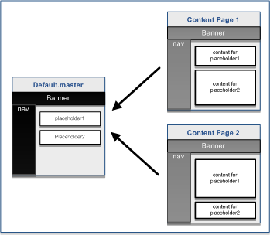
ASP.NET Syntax for Master Pages
<!-- myLayout.master -->
<%@ Master %>
<html><body>
<form id="frmMain" runat="server">
<table width="100%">
<tr>
<td>
<h1>Wingtip Inc.</h1><hr />
</td>
</tr>
<tr>
<td> <!-- Main Body of Page -->
<asp:contentplaceholder
id="PlaceHolderMain"
runat="server" />
</td>
</tr>
</table>
</form>
</body></html>
myLayout.master
<!-- content page linking to default.master -->
<%@ Page MasterPageFile="myLayout.master" %>
<asp:Content ID="Main" ContentPlaceHolderID="PlaceHolderMain">
Unique page content goes here
</asp:Content>
Notes:
A typical master page contains the default layout for a content page including high-level page elements such as HTML, HEAD, BODY and FORM.
Within these standard HTML elements on a master page, you find two important types of components:
Controls for links, menus, icons and navigation components
Named placeholders
Named placeholders are an essential aspect of master pages. They provide an extensibility mechanism used to add unique content to content pages that are linked to the master page.
Whenever overriding a named placeholder in a content page, you must create a asp:Content control which contains a ContentPlaceHolderID attribute which references a valid placeholder defined on the master page.
This point is critical to understand when working with master pages in SharePoint 2010 sites. A content page will experience a runtime error if it contains a asp:Content control with a ContentPlaceHolderID attribute value that does not match one of the placeholders defined in the master page.

Slide 4
Agenda
ASP.NET Syntax for Master Pages
The Master Page Gallery
Walkthrough of v4.master
Adding Site Pages
Customizing v4.master

Slide 5
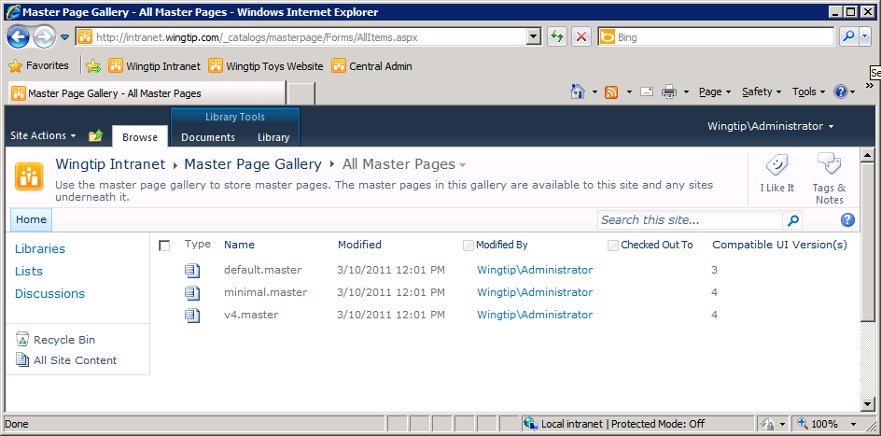
The Master Page Gallery
Each site has a Master Page Gallery
  v4.master used for page layout in SharePoint 2010
  minimal.master used in a few sites (e.g. Search Center)
  default.master used to create SharePoint 2007 UI
Notes:
SharePoint Foundation is designed around the concept of master pages. The obvious benefit of this is that all the pages in a SharePoint site can link to a single master page to achieve a consistent look and feel. Note that enhancements were made in SharePoint 2010 so that site pages and application pages could link to the same master page. This is a nice enhancement of SharePoint 2007, which had limitations that made it difficult to support linking site pages and application pages to the same master page.
Whenever SharePoint Foundation provisions a new site, it creates a special hidden document library known as the Master Page Gallery. In addition to creating the Master Page Gallery in each new site, SharePoint Foundation provisions the following three master page instances:
v4.master
minimal.master
default.master
The master page named v4.master is the primary master page used in SharePoint 2010 sites. For example, v4.master is what gives Team sites in SharePoint 2010 a common page layout across site pages and application pages. This common layout is what some designers and developers refer to as the "chrome" of the page because it includes familiar elements such as the Site Actions menu, the breadcrumb trail, the Ribbon, the Welcome menu, the Site Icon, the TopNav bar, and the Quick Launch

Slide 6
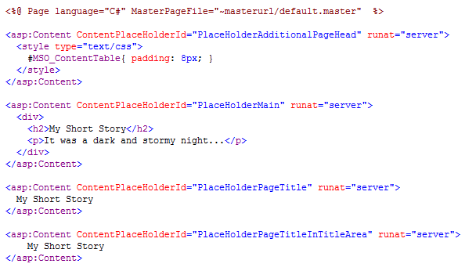
A Sample Content Page
~masterurl/default.master is a dynamic token
  Replaced with master page for current site
  Has a default value of v4.master
  Can be modify to point to another master page
Notes:
When you examine the site page supplied by SharePoint Foundation and SharePoint
Server 2010, you will discover that they use the standard MasterPageFile attribute, which is understood and interpreted by the ASP.NET runtime. However, these site page templates use a dynamic token value of ~masterurl/default.master.
<%@ Page MasterPageFile="~masterurl/default.master" %>
The obvious question now becomes what the meaning of ~masterurl/default.master is. This dynamic token is a key part of the strategy that SharePoint Foundation employs to swap out the master page used by all the pages in a site. Each SharePoint site (i. e. SPWeb object) has a property named MasterUrl, which is initialized to reference the instance of v4.master in the current site. When SharePoint Foundation processes a site page, it inspects the page’s MasterPageFile attribute. If the MasterPageFile attribute has a token value of ~masterurl/default.master, SharePoint Foundation replaces it with the MasterUrl property value of the current site. After SharePoint Foundation performs this substitution, it passes the site page over to ASP.NET for parsing and execution.
What is important to see is that all the pages in a site initially link to v4.master. However, you can modify the value of the MasterUrl property for an SPWeb object to reference a different master page. This has the effect of swapping out one master page for another.

Slide 7
v4.master has many Content Placeholders
PlaceHolderMain
PlaceHolderAdditionalPageHead
PlaceHolderPageTitle
PlaceHolderPageTitleInTitleArea
PlaceHolderPageDescription
PlaceHolderGlobalNavigation
PlaceHolderTitleBreadcrumb
PlaceHolderGlobalNavigationSiteMap
SPNavigation
PlaceHolderSiteName
PlaceHolderSearchArea
PlaceHolderTopNavBar
PlaceHolderHorizontalNav
PlaceHolderFormDigest
PlaceHolderLeftNavBarDataSource
PlaceHolderCalendarNavigator
PlaceHolderLeftActions
PlaceHolderLeftNavBarTop
PlaceHolderLeftNavBar
PlaceHolderQuickLaunchTop
PlaceHolderQuickLaunchBottom
PlaceHolderPageImage
PlaceHolderLeftNavBarBorder
PlaceHolderMiniConsole
PlaceHolderNavSpacer
PlaceHolderTitleAreaClass
PlaceHolderBodyAreaClass
PlaceHolderBodyLeftBorder
PlaceHolderBodyRightMargin
PlaceHolderTitleAreaSeparator
PlaceHolderTitleLeftBorder
PlaceHolderTitleRightMargin
WSSDesignConsole
Notes:
Learning about the ContentPlaceHolder controls that exist in v4.master is important because they provide the extensibility mechanism used to add unique content to site page. There are 34 named placeholders in all. Here is a brief listing of the ones that are most frequently used in SharePoint 2010.
PlaceHolderMain: Main content of the page.
PlaceHolderAdditionalPageHead: Used to add CSS and JavaScript to head section of page.
PlaceHolderSiteName: Name of the site where the current page resides.
PlaceHolderPageTitle: The title of the site shown in top title bar browser.
PlaceHolderPageTitleInTitleArea: The title of the page appearing in title area of page.
PlaceHolderPageDescription: Description of the current page.
PlaceHolderSearchArea: Section of the page for the search box and controls.
PlaceHolderTopNavBar: Container used to hold the top navigation bar.
PlaceHolderHorizontalNav: Navigation menu that is inside the top navigation bar.
PlaceHolderTitleBreadcrumb Breadcrumb text for the breadcrumb control.
PlaceHolderGlobalNavigation Global navigation (aka Top Link Bar)
PlaceHolderGlobalNavigationSiteMap: Control for getting list of child sites.
PlaceHolderLeftNavBar: Quick Launch navigation bar.
PlaceHolderLeftNavBarDataSource: Data source for Quick Launch
PlaceHolderFormDigest: Container where the page form digest control is stored.
PlaceHolderUtilityContent: Additional content at bottom of page outside the form tag.

Slide 8
DEMO
Adding Content Placeholders to a Site Page

Slide 9
Agenda
ASP.NET Syntax for Master Pages
The Master Page Gallery
Walkthrough of v4.master
Customizing v4.master

Slide 10
Understanding v4.master
By default, all pages in site link to v4.master
  v4.master links to CSS files including corev4.css
  v4.master links to rich client-side library of *.js files
What developers need to know about v4.master
  General HMTL layout of important <div> elements
  Named placeholders and their locations
  How to extend corev4.css with additional formatting
  How to add JavaScript and leverage out-of-box APIs
Notes:
The master page named v4.master is widely used in SharePoint Foundation. For example, it
defines the standard layout for every page in a team site. The v4.master page can also serve as the master page for the site pages that you create within a SharePoint branding project.
To understand the best practice for creating pages that link to v4.master, it’s important that
you have a basic understanding of what’s defined inside. It’s worth your time to open a copy of the v4.master file in Code view within SharePoint Designer and try to absorb all that’s in there. While it might take some time to get to know everything inside v4.master, it’s a worthwhile investment for any Web designer who is serious about designing pages and mastering branding techniques in SharePoint 2010.
The v4.master page contains the basic HTML layout for a page, including standard elements
such as html, head, body, and form, and includes many server-side controls that are used to
encapsulate logic and user interface components. Examples of these server-side controls include the SPWebPartManager control and controls to provide navigation components, such as breadcrumb trails and menus for navigating around the site.

Slide 11
DEMO
Making a Copy of v4.master for Exploration

Slide 12
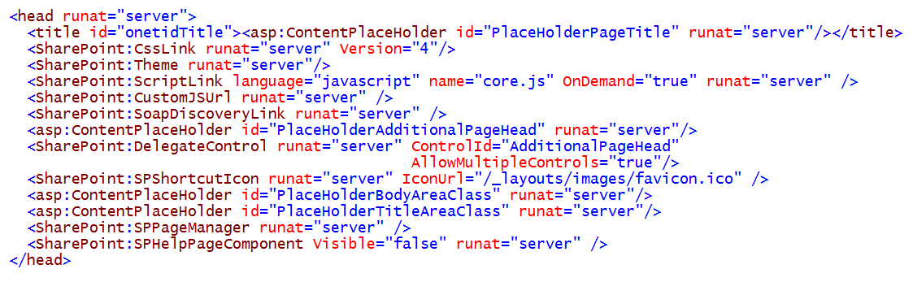
<head> Element of v4.master
The head section contains important controls
  Placeholder controls for page title and head content
  Controls that add in links to CSS and JavaScript files
Notes:
Head Section Controls
CssLink: adds the link to corev4.css and a link to CSS file for AlternateCSSUrl property of SPWeb.
Theme: adds CSS link if a theme is applied to site.
ScriptLink: adds links to standard SharePoint 2010 JavaScript files such as core.js and sp.js.
CustomJSUrl: adds link to custom JavaScript file for CustomJavaScriptFileUrl of SPWeb.
SoapDiscoveryLink: Creates a link to a .disco file for SOAP Web Service discovery.
SPShortcutIcon: used to change the favicon in browser to a custom .ico file.
SPHelpPageComponent: adds JavaScript code to initialize the help system for the page.
Head Section Placeholders
PlaceHolderAdditionalPageHead: used to add CSS rules, JavaScript and HTTP metadata.
PlaceHolderBodyAreaClass: added for backwards compatibility with SharePoint 2007.
PlaceHolderTitleAreaClass: added for backwards compatibility with SharePoint 2007.
Head Section Delegates
AdditonalPageHead: used with a delegate control to add CSS rules and JavaScript.

Slide 13

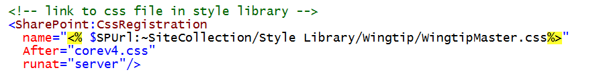
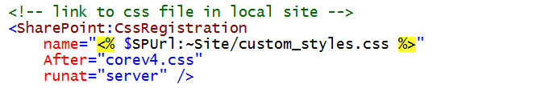
Linking to a Custom CSS File
Create CSS file links using CssRegistration control
  Control should be added to head section
  $SPUrl expression required for sites not at root of Web Application
Notes:
In some cases such as when linking a single page to a CSS file you can use a simple
<asp:Content ContentPlaceHolderId="PlaceHolderAdditionalPageHead" runat="server">
<link rel="stylesheet" type="text/css" href="styles.css" />
</asp:Content>
However, there is a problem when creating master pages because you have to deal with pages at the root of the site as well as pages inside folders. Therefore, you cannot hardcode a path to the CSS file. You can use the CssRegistration control together with an $SPUrl expression to solve this problem. This makes it possible to calculate the path from a specific page to a CSS file at runtime.
Typically you want your custom CSS files to be linked after the corev4.css file so your styles override the standard SharePoint 2010 CSS rules. Therefore, you should include the After attribute with the CssRegistration control and give it a value of corev4.css .
CAVEAT: The $SPUrl expression is included as part of SharePoint Server 2010 and is not part of SharePoint Foundation. When using the $SPUrl expression you should always be able to make the assumption that your code will run exclusively in SharePoint Server 2010 farms and will never have to run in a farm running on SharePoint Foundation.

Slide 14


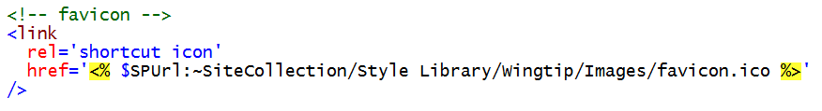

Customizing the Shortcut Icon
For site collections at root of Web Application
For site collections not at root of Web Application
  SPShortcutIcon control does not support $SPUrl expression
  You can create the correct link using $SPUrl expression alone
  This is what actually gets generated and sent to browser
Notes:
The SPShortcutIcon control makes it possible to change the favicon shown in the browser. The top example shows how to point to a custom .ico file for a site collection which is at the root of a Web application.
There is an unfortunate problem when customizing the favicon for a site collection which is not at the root of a Web application. The problem is caused by the fact that the $SPUrl expression cannot be used for the IconUrl property of the SPShortcutIcon control due to a type mismatch. The second code listing in this slides shows a potential solution. The third code listing shows the link control that is generated.

Slide 15
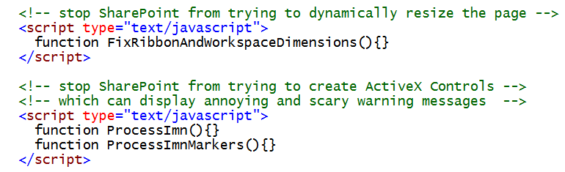
Overriding Built-in JavaScript Function
SharePoint calls JavaScript functions
  Called whenever page is loaded or refreshed
  Some functions do things you don’t want them to do
  Add script element to head section to override functions
  Overridden by creating empty function with same name
Notes:
When modifying the head section of a master page, it is sometimes necessary to add empty JavaScript functions to override and effectively disable some of the standard functionality provided by SharePoint 2010.
The new user interface of SharePoint 2010 employs JavaScript code to resize the height and width of page elements each time a page is loaded or refreshed. This is usually something that you want to occur. However, this might be harmful to certain custom master page designs. You can disable this resizing behavior by adding an empty implementation of the FixRibbonAndWorkspaceDimensions function as shown in the slide. Later in this lecture you will see that it is possible to disable page width resizing and keep the height resizing by adding the s4-nosetwidth class to the div with the id of s4-workspace.
Another common problem is caused by the fact that SharePoint 2010 uses JavaScript to add ActiveX controls to the page for browsers add-ons which often bring up ugly warning and/or error message which you typically want to avoid. Adding empty JavaScript functions named ProcessImn and ProcessImnMarkers will prevent the page from attempting to load these undesired add-on s.

Slide 16
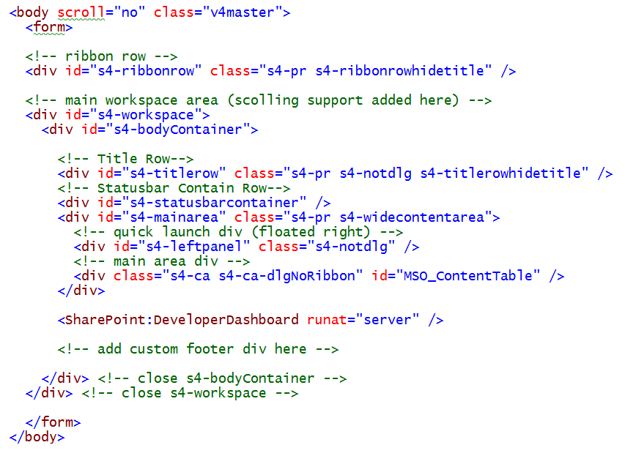
<body> Element of v4.master
Notes:
The body section of v4.master is defined with two main top-level div elements which are named s4-ribbonrow and S4-workspace. The s4-ribbonrow div contains the ribbon and the s4-workspace div contains everything else down below.
Note that v4.master provides a customized scroll system where the body is locked in place using the scroll attribute which is configured with a value of no. The ability to scroll the page downward when there is too much content to view at once is enabled in the div with the id of s4-workspace using the CSS overflow property.

Slide 17
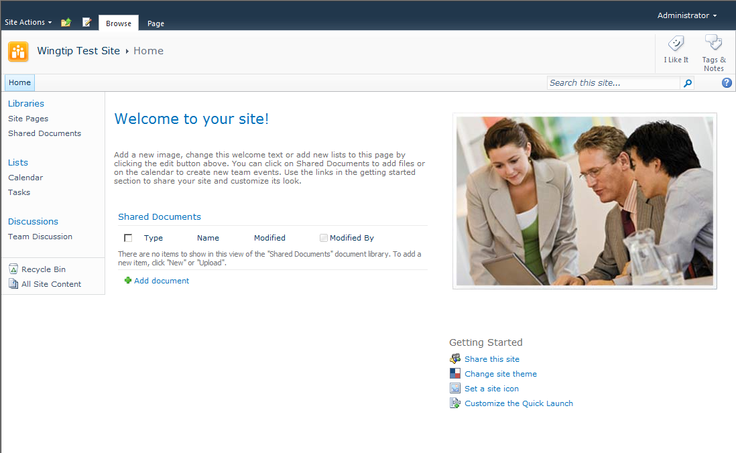
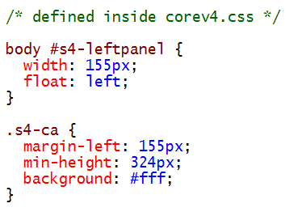
Named <div> tags in v4.master
<div id="s4-ribbonrow“>
<div id="s4-workspace">
<div id="s4-bodyContainer">
<div id="s4-titlerow">
<div id="s4-leftpanel">
<div class="s4-ca" id="MSO_ContentTable">
</div> s4-bodyContainer
</div> s4-workspace
Notes:
The s4-ribbonrow div is the container for the server ribbon and the site actions menu.
The s4-workspace div is the container for all the other div elements shown on the slides including the s4-bodyContainer div which sets a minimum width of 760 pixels. The div with an id of s4-titlerow contains title, tags and main navigation. Under the s4-titlerow div there are two div elements with ids if s4-leftpanel and MSO_ContentTable which are display side by side. The s4-leftpanel div is floated to the left using the CSS float property and serves as a container for the left navigation and the Quick Launch. The MSO_ContentTable div has a left margin of 155pixels and is the container for the main content of the page.

Slide 18
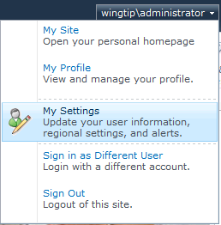
Welcome Menu
Provided by user control
  Page must contain Register directive
  Page must also contain control tag
Notes:
The Welcome menu is implemented and deployed by SharePoint using a custom control file named Welcome.ascx. This means v4.master must contain a Register directive as well as a control tag to instantiate the control instance on the page. The typical view of the Welcome menu is shown in the slide above. However, the view of the Welcome menu is reduced to a single link with a caption of sign in when the user as not authenticated and is running with anonymous access.

Slide 19
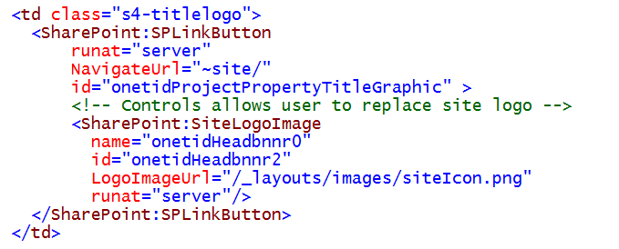
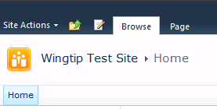
Site Logo
Provides replaceable site logo image
Notes:
The SiteLogoImage control provides a logo for the site which by default uses the out-of-box image file named siteIcon.png. However, the image can be customized by the user through the standard SharePoint UI using the Title, Description, and Icon page which is accessible from a link on the Site Settings page. Behind the scenes, SharePoint uses a site property on the SPWeb object named SiteLogoUrl to track whether to show a customized logo image. When the SiteLogoUrl property of a site is empty, SharePoint then uses the default image file named siteIcon.png.

Slide 20
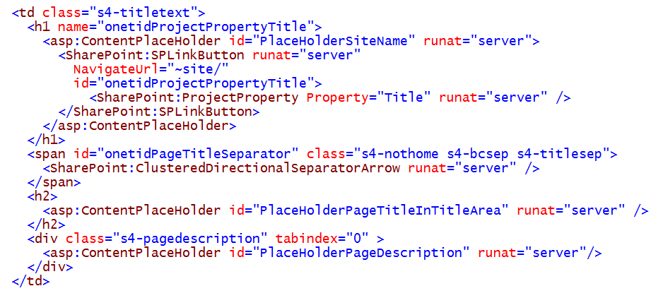
Site Title
Provides a simple breadcrumb
Notes:
The Site Title is display on pages using the SharePoint:ProjectProperty control which has a Property attribute value of Title. Note that this control is placed inside a SPLinkButton control whose NavigateUrl attribute has a value of ~site. This gives the site title the ability to link to the home page of the current site. To the right of the Site Title there are also placeholders named PlaceHolderPageTitleInTitleArea and PlaceHolderPageDescription.

Slide 21
Navigation
Navigation enabled using three page elements
  Global Breadcrumb
  Top Link Bar
  Quick Launch Bar
Navigation very different in publishing sites
  This module covers navigation in Team sites
  Later module covers navigation in publishing sites
Notes:
The user navigation in v4.master is enabled using the following three page elements
Global Breadcrumb
Top Link Bar
Quick Launch Bar
These three elements will be discussed in more detail over the next few slides. However, it should be noted that the way in which navigation is set up behind the scenes works very differently in team sites than it does in publishing sites. This module covers navigation in Team sites but you should not assume what is covered here also applied to navigation in publishing sites. A later module discussed what is different about navigation in publishing sites.

Slide 22
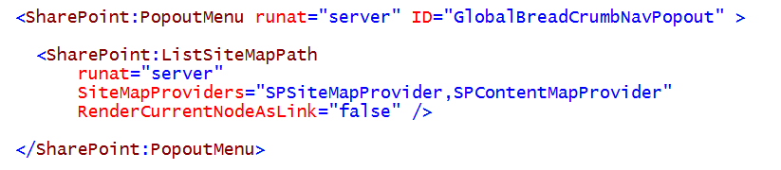
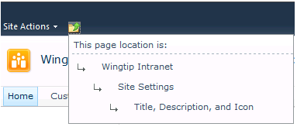
Global Breadcrumb
Notes:
The breadcrumb appears in the ribbon just to the right of the Site Actions menu. It is marked by an folder icon with an up pointing arrow. When your mouse pointer hovers over the icon, a tooltip displays "Navigate Up." When you click the icon, a pop-out menu appears. This menu shows your current position in the site hierarchy. Clicking any of the links that precede your current position navigates to that location, providing a way to move up the hierarchy.
The breadcrumb is positioned inside the placeholder named PlaceHolderGlobalNavigation. which means it can be replaced or removed by a content page which overrides that placeholder. The menu itself is rendered with a PopoutMenu control. This control contains a Label control for the menu header and a ListSiteMapPath control for the hyperlinks that enable users to navigate the website. The ListSiteMapPath control is nested within another placeholder named PlaceHolderTitleBreadcrumb so it can be overridden as well.
The ListSiteMapPath control gets its navigational data from a pair of providers, SPSiteMapProvider and SPContentMapProvider. The first provides navigation nodes fro the sites in the current site collection hierarchy and the second provides navigation nodes for pages, lists, libraries and folders in the current sites.
.

Slide 23
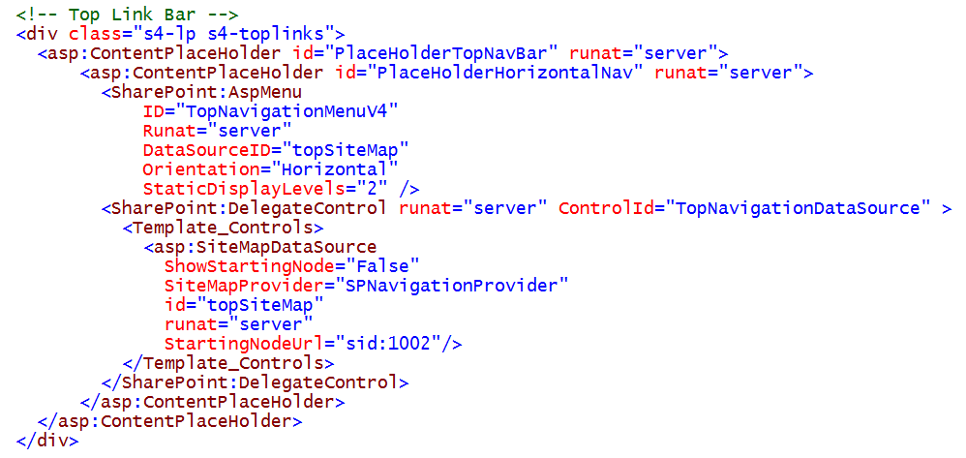
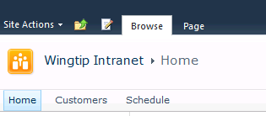
Top Link Bar (aka Global Navigation)
Notes:
The top link bar is a tabbed strip that appears just below the site's title and description. The first link on the top link bar is the "Home" position. Often this link points to the website where the bar is defined, and the remaining links point to pages in the current site and to sites lower down in the site hierarchy. However, this standard is not enforced. Any valid URL can be used for a link, and links can be arranged in any order.
The top link bar is rendered by an AspMenu control. The menu renders horizontally, a direction that the markup for the control specifies by setting the Orientation property to Horizontal. If the menu structure is deeper than two levels, items on the third level display on a flyout menu, an effect that is controlled by the MaximumDynamicDisplayLevels property. Because this setting is 1, flyout menus display only one level below the two that appear on the static menu. All additional levels are discarded.
The data source behind the menu is a SiteMapDataSource control. As you can see from the markup, the SiteMapProvider property binds the data source control to an instance of the SPNavigationProvider class. You might also notice that the value of the ShowStartingNode property is False. This is because the actual starting node is the root of the node tree that forms the top link bar; it serves an internal function and is not meant to be rendered on the page. The value of the StartingNodeUrl property, sid:1002, is not a proper URL but instead is an expression that points to the SharePoint identifier for the top link bar's root node.

Slide 24
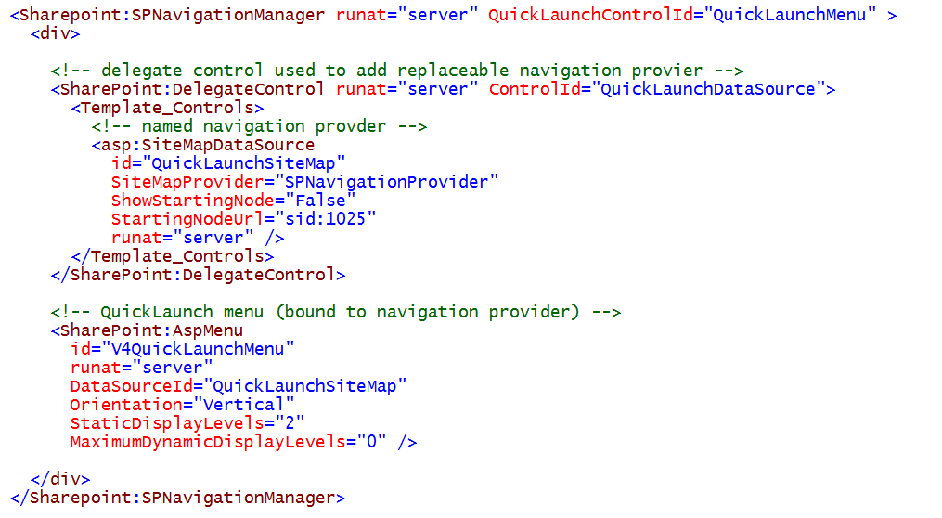
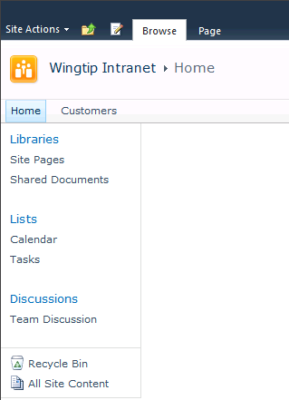
Quick Launch Bar (aka Current Navigation)
Notes:
Quick Launch is a menu of links that can appear on the left side of pages in a site. The menu is intended for navigation within the current site and usually has links to lists and document libraries and other site content. It can also include links to external content.
In v4.master, the markup that defines the Quick Launch menu is nested inside the placeholder control with an id of PlaceHolderLeftNavBar. The markup for the Quick Launch menu defines two versions, each within a UIVersionedContent control. For one UIVersionedContent control, the value of the UIVersion attribute is 3 which means it only applies to pages running under the older SharePoint 2007 UI mode. For most situations where pages are running in the SharePoint 2010 UI mode, the value is of the UIVersion is 4.
The Quick Launch menu appears as a series of headings that may have one or more levels of menu items beneath them. The number of menu levels that are actually rendered on the page depends on the configuration of the AspMenu control that renders the menu. The value of the StaticDisplayLevels property is 2 by default, meaning that two menu levels are displayed: a heading plus one level below the heading. Additional levels below these two heading can be displayed in a dynamic, flyout menu. How many levels display on the flyout menu is governed by the setting for the MaximumDynamicDisplayLevels property.

Slide 25
Understanding Delegate Controls
Delegate Control acts of control placeholder
  Delegate controls allows for control substitution
  Control substitution driven through feature activation
Delegate controls used in v4.master
  Search box
  Top Link Bar data source
  Quick Launch Bar data source
Notes:
A delegate control is a control placeholder that allows you to substitute in one or more control instances during the processing of a page. SharePoint Foundation provides a consistent set of delegate controls in its standard master pages such as v4.master.
While delegate controls have similarities to placeholder controls, they also have their differences. One major difference is that the substitution mechanism used for replacing the contents of a delegate control is driven by feature activation. Therefore, you can replace what’s defined inside a delegate control in v4.master without requiring any changes to v4.master or any of the site pages or application pages that link to it. All you need to do is define a feature with a Control element and then activate that feature.
There are quite a few features in SharePoint Server 2010 that rely on the delegate controls defined inside v4.master. If you remove or modify the delegate controls inside v4.master, it can have the effect of breaking functionality. For example, the data sources for both the Top Nav Bar and the Quick Launch bar are wrapped in delegate controls. These data sources are swapped out by a feature which is enabled in all publishing sites. If you remove these delegate controls from v4.master, you might have created a custom master page that does not work in publishing sites.

Slide 26
Agenda
ASP.NET Syntax for Master Pages
The Master Page Gallery
Walkthrough of v4.master
Customizing v4.master

Slide 27
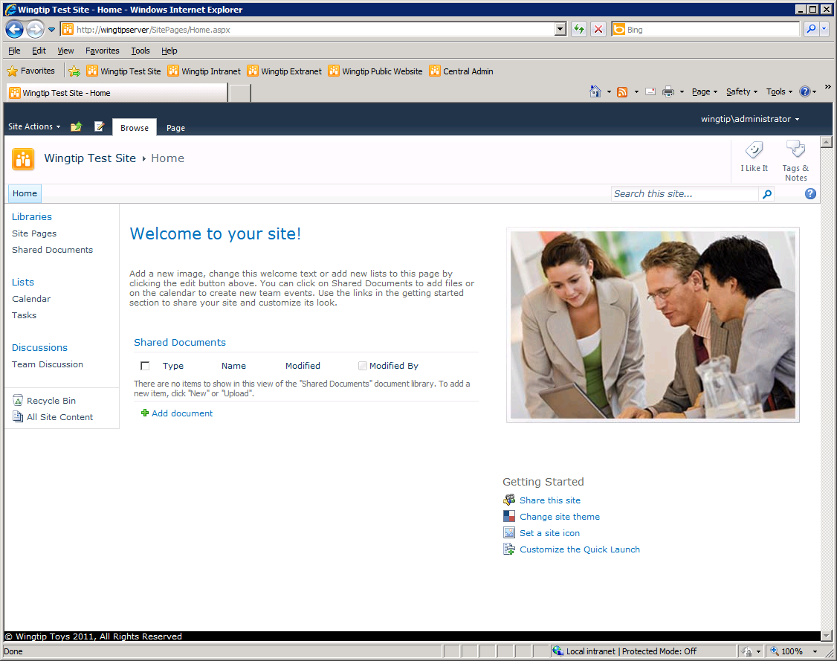
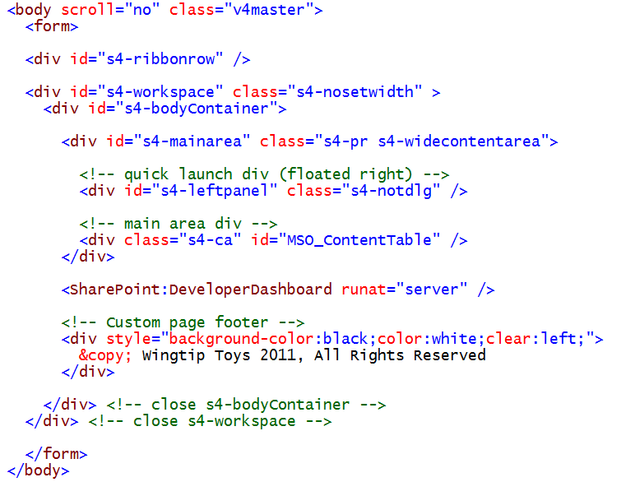
Adding A Custom Footer
Notes:
A custom footer can be added to pages of a site by customizing v4.master and adding a new div element just below the div element for the developer dashboard. Note that you must add a CSS style of clear which is assign a value of either left or both.

Slide 28
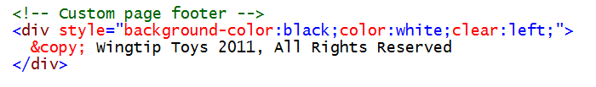
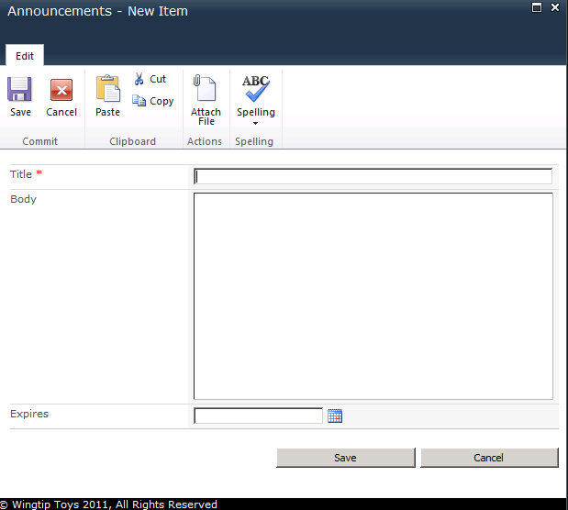
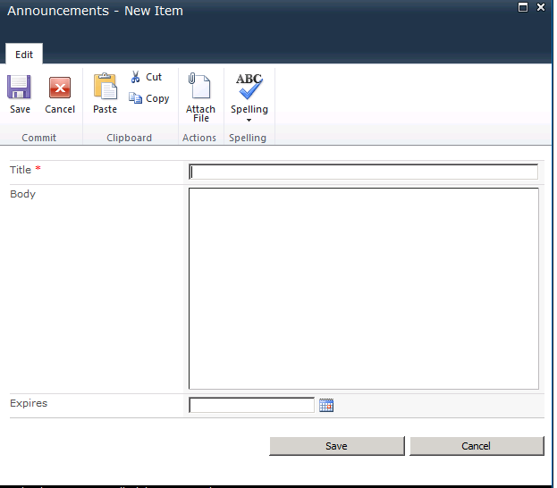
Applying the s4-notdlg Class
s4-notdlg used to remove element from dialogs
  Often used for banners and footers
Notes:
There are times when you want to add an element to a master page such as a page footer that you do not want to appear in pages that are displayed as dialogs. Fortunately, you can simply assign a standard class named s4-notdlg to these types of elements. This is all that is required to ensure the element never appears on pages displayed as dialogs.

Slide 29
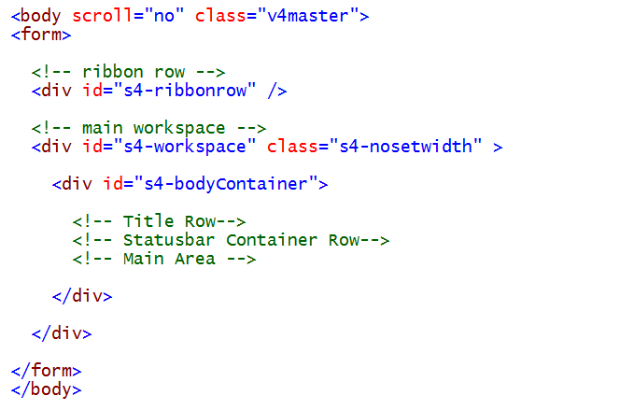
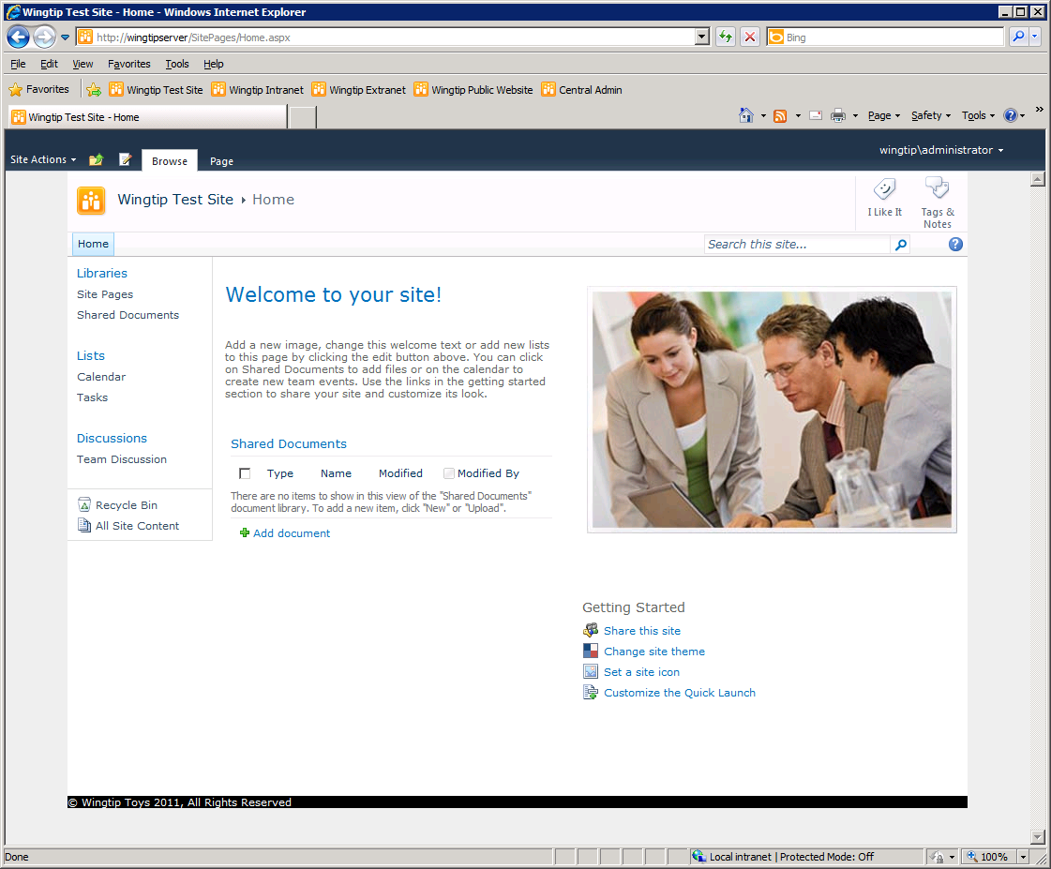
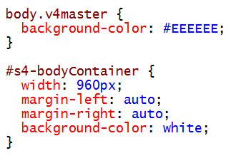
Creating a Fixed-width Master Page
You must add this class
Notes:
In the demo, your instructor will take you through the steps of creating a fixed width page. One aspect of this will involve assigning a class of s4-nosetwidth to the s4-workspace div. This has the effect of cancelling the built-in SharePoint behavior of resizing the page width using JavaScript.

Slide 30
DEMO
Customizing a Master Page

Slide 31
Summary
ASP.NET Syntax for Master Pages
The Master Page Gallery
Walkthrough of v4.master
Customizing v4.master

